Slide 1


A movie recommendation system that uses your historical preferences data to accurately predict movies you would enjoy.
Notes:
Open by talking about the need for recommendation systems, their application in different kinds of businesses and a brief on their economic importance. You may site examples like e-commerce stores, Facebook friend recommendations, Netflix and youtube, then Zero in on the product and explain that screenlot is a recommender system for movies based on a movie database that has been updated since the 1920s.

Slide 2


Data port incorporated are the developers of screenlot as an application. The name “Screenlot”, it’s logo and software are proprietary products and are all registered to Dataport inc.
ABOUT DATA PORT INCORPORATED
Notes:
Talk about data port as the company behind screenlot, and the owners of the screenlot brand. Ensure that the distinction between screenlot and data port is clearly established and make it a point to state that Screenlot is not the only product offered by dataport but also make it clear that screenlot is the focus of this presentation.

Slide 3





OUR TEAM
PRINCE OKON
DANIEL ODUKOYA
HUZAIFA ABU
IRIRI JERRY
IZUNNA ENEUDE
Team lead
Administrator
Technical Lead
Chief Designer
Quality Control
Our development team is a group of professionals in Administration, Business Management and the technical side of product development.
Notes:
The team are the professionals behind the company (Data port). Take the time to explain the role of each team member and how that role adds value to the overall team and why this team is competent to develop and deliver the products that the company produces in general and the screenlot app in particular. Also touch on the different aspects of the companies operations and how each of these professionals fits the role nicely as well as the edge they have over other companies.

Slide 4
CONTENT OF PRESENTATION
Introduction
EDA / Data Engineering
01
04
Problem
02
Models Exploration
05
Solution
03
Conclusion
06
Notes:
Run through a summary of the table of contents and what the audience should expect from this presentation. You may seize the opportunity to bring to their notice special things they should watch out for in the various sub-topics in our presentation.

Slide 5
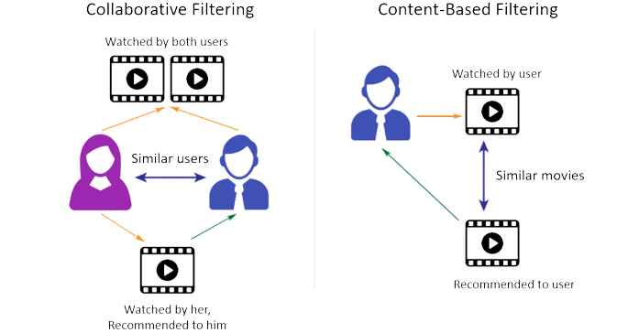
INTRODUCTION
Definition of Recommendation systems.
Types
Collaborative filtering
Content based filtering
Notes:
Stress the distinction between the collaborative and the content based filtering systems in recommendation engines. Emphasize the social bias of collaborative based filtering, which relies on the preferences of others to create a prediction while content based relies on the intrinsic qualities of the data in question to generate predictions. At the end of the day, rely on the audiences understanding of these two to present the 3rd type of recommendation system, which is the hybrid.

Slide 6
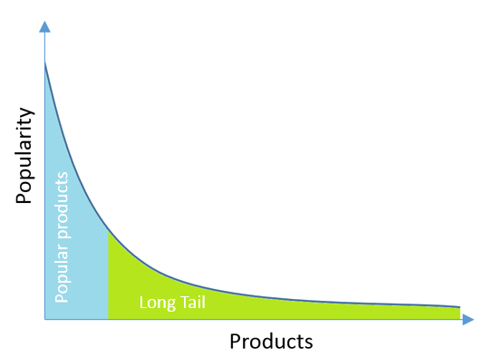
THE PROBLEM
In business, many customers tend to desire low volumes of Items that are relatively unpopular. This phenomenon is known as the long tail.
Notes:
Explain the problem of the long tail and how that has been a major concern for businesses over time. Explain how the long tail can account for up to half of a companies profit and how not paying attention to it can also lead to foregone profits, also known as losses. Explain how recommendation engines solves the problem of the long tail and how they bring content to (matching) people who are very likely to want such content. Emphasize that these contents would never have been brought to these people but for the use of recommendation systems as a service.

Slide 7
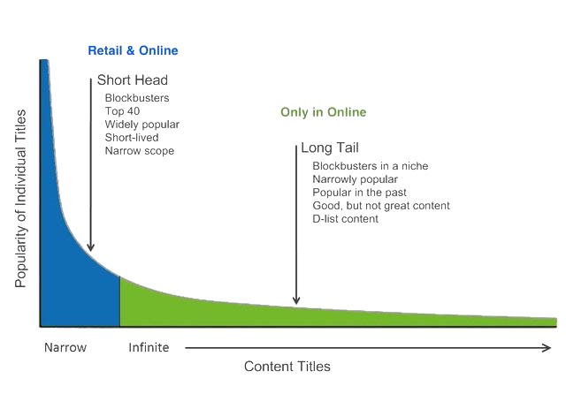
SOLUTION
A movie recommendation algorithm that makes accurate predictions of a user’s movie preferences from historical choices
Notes:
Explain that the EDA will generally speak to the above listed categories and offer a brief description of the categories. Explain that the EDA will expose insights about the data that may not be seen otherwise and show how theses and other features will influence how clusters will eventually form.

Slide 8




Exploratory Data Analysis (EDA) Features
USER RATINGS
MOVIES
GENRES
DIRECTORS
Notes:
Explain that the EDA will generally speak to the above listed categories and offer a brief description of the categories. Explain that the EDA will expose insights about the data that may not be seen otherwise and show how theses and other features will influence how clusters will eventually form.

Slide 9
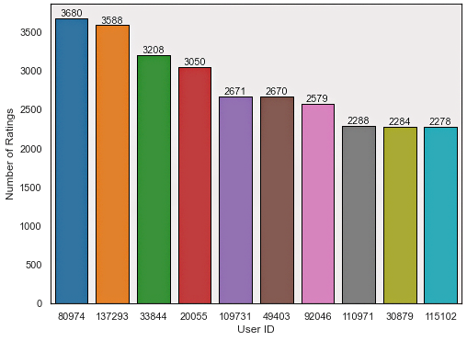
USER RATINGS
TOP USER RATINGS
Notes:
Explain the parameter that this graphic shows. Stress that the higher the numbers of ratings by a particular user, the better the a collaborative model will be at predicting that users taste in movies. The better it will also be at using the available ratings to make predictions for users with less activity as well, so generally, the more the user ratings available, the better for the algorithm.

Slide 10
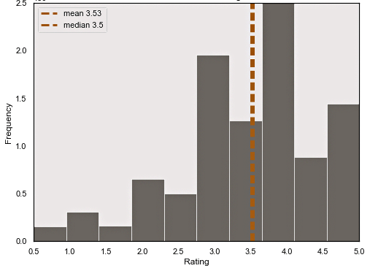
USER RATINGS
DISTRIBUTION OF USER RATINGS
Notes:
Explain that the graph shows the ratings that are ascribed to movies by the users who actually take the time to rate each movie. Stress that the 4 star rating has the highest number of ascribed ratings while the 5 star rating comes 3rd after the 3 star rating. End by stating that only the 5 star ratings are considered in the development of our model

Slide 11
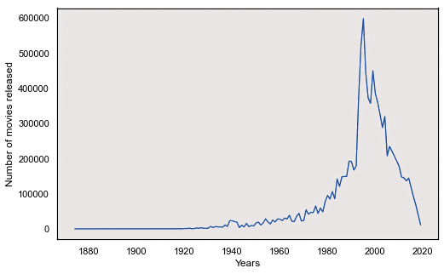
MOVIES
MOVIES RELEASED PER YEAR

Slide 12
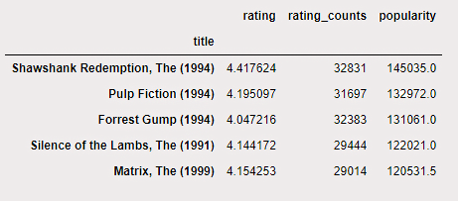
MOVIES
MOVIES RATINGS
Notes:
Note: This slide contains repeated information. This is the same info represented by the vertical Bar chart 2 slides above. Please replace it with a graph that shows the most rated movie which i presume is shawshank redemption. That will justify the slide below and make for an intuitive preceding content.

Slide 13
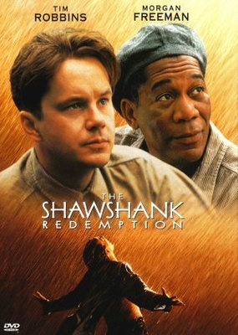
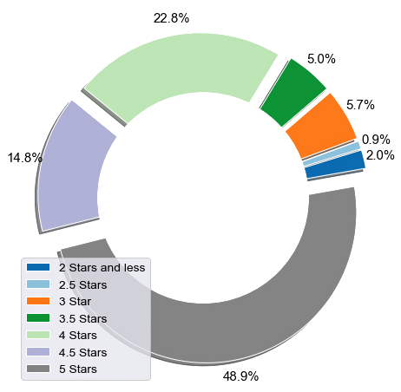
MOVIES
HIGHEST RATED MOVIE
Notes:
Stress that The Shawshank Redemption is the movie with the most 5 star ratings of all the rated movies in the entire database with 48.9% of al it’sl ratings (Almost half) being 5 star ratings. The movie poster is made to provide a visual tease of the stars that featured in the movie..

Slide 14
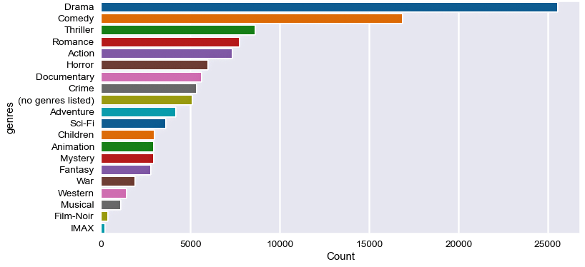
GENRES
NUMBER OF MOVIES PER GENRE
Notes:
Observe that the most popular genre is the drama genre with a 5 star rating count in excess of 25,000. It is followed by the comedy genre with thriller, romance and action coming closely behind. Note that this bar chart only shows the ratings for the top 20 genres. Other genres exists but failed to make it to this list. To refer to the long tail analogy, the Drama and Comedy genres will form the head of the

Slide 15
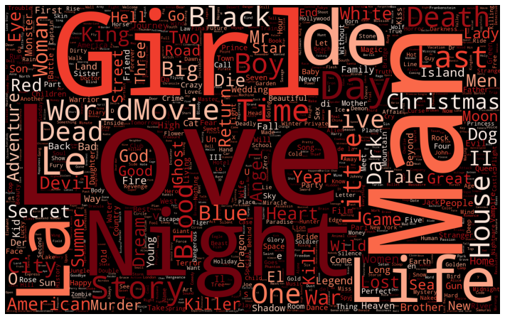
GENRES
WORD CLOUD SHOWING RATED MOVIES BY GENRE
Notes:
Drama is by far the most popular rated genre. The wordclouds most prominent words are therefore words that are associated with drama such as Love, Man, Night, Girl etc. Adventure and thriller themes are also popular though not as popular as drama, hence titles such as Christmas, House, Black, Story etc. The smaller the text size in the word cloud, the less significant the genre represented by that word.

Slide 16
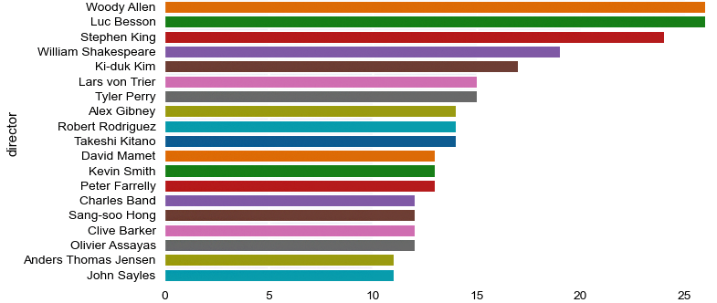
DIRECTORS
MOVIE COUNT BY DIRECTORS
Notes:
This chart shows the No. of Movies by Directors. The bar chart shows that Woody Allen and Luc Besson Directed the most movies.

Slide 17
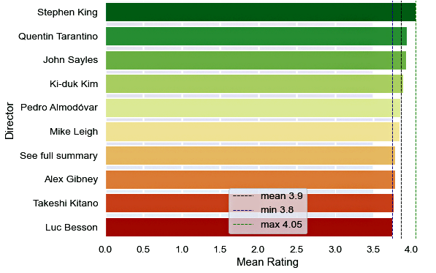
DIRECTORS
HIGH RATINGS

Slide 18
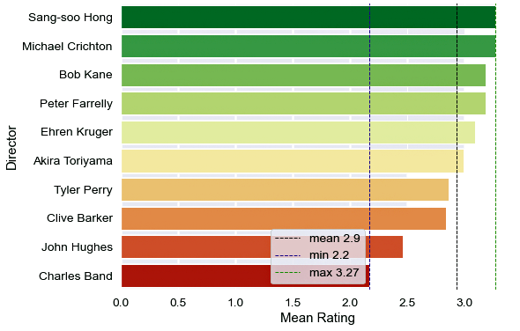
DIRECTORS
LOW RATINGS

Slide 19

MODEL BUILDING
MULTIDIMENSIONAL SCALING
PRINCIPAL COMPONENT ANALYSIS
TSNE (T stochastic neighbor Embedding)
MODEL FITTING
Notes:
Multidimensional Scaling: Multidimensional scaling (MDS) is a technique that creates a map displaying the relative positions of a number of objects, given only a table of the distances between them. The map may consist of one, two, three, or even more dimensions.
Principal Component Analysis: Principal component analysis, or PCA, is a statistical procedure that allows you to summarize the information content in large data tables by means of a smaller set of “summary indices” that can be more easily visualized and analyzed. To properly carry out PCA, we have to first establish the feature of greatest importance and eliminate features of less importance.
tSNE: t-distributed stochastic neighbor embedding (t-SNE) is a statistical method for visualizing high-dimensional data by giving each datapoint a location in a two or three-dimensional map. It is based on Stochastic Neighbor Embedding
Model Fitting: After completing the processes above, you finally fit the built model to the data.

Slide 20
Why we carry out cross validation
The K-fold cross validation / Hyperparameter settings used.
CROSS VALIDATION
Notes:
We tested the accuracy of a model's prediction on unseen data (validation sets) To check issues such as over/underfitting and selection bias.
We used the K-fold technique to perform cross validation on our two best performing models which are SVD and Baseline Only. The epoch setting used is 40.

Slide 21
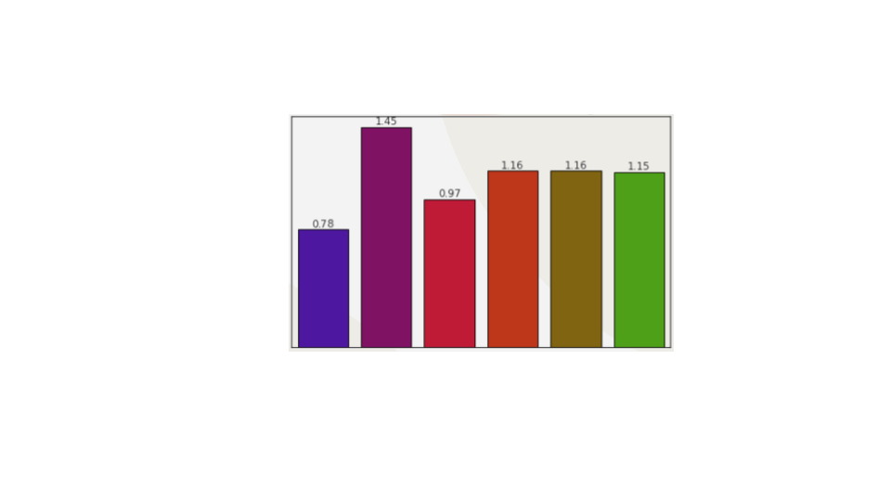
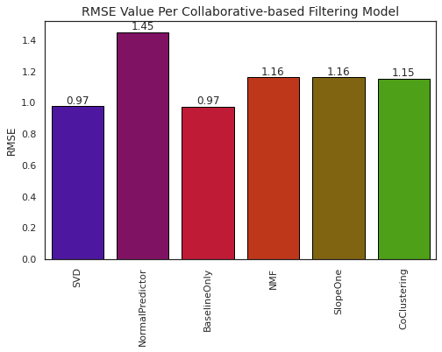
0.786
MODEL PERFORMANCE EVALUATION
RMSE
Notes:
We built and tested multiple collaborative and content based filtering models and compared their performance using a statistical measure known as the root mean squared error (RMSE), which determines the average squared difference between the estimated values and the actual value. A low RMSE value indicates high model accuracy while a high model RMSE indicates a less accurate model.

Slide 22

STREAMLIT DEPLOYMENT
SCREEN LOT WEB APP
Our user-friendly app, recommend movies and explore data insights.
Notes:
Sit back as we show you just how screen lot works

Slide 23
CONCLUSION
Screenlot is a top-notch Movie recommender solution, Why?
User-friendly
Saves time
Excellent and hassle-free Movie recommendation
Drastically improve profit for businesses

Slide 24
WHY CHOOSE SCREENLOT?
There are hordes of Recommender systems out there but we stand out because;
Data Source
Regular updates.
Active feedback implement
Customization Options
Notes:
There are hordes of Recommender systems out there but we stand out because;
Our system is generated from well cleaned and processed data and the good quality of the data used as input results in a good product.
Even though we have a decent predictive accuracy, we are still able to improve the quality of our product via regular updates.
We actively seek feedback from our client and implement the suggestion they have for product improvement.
Screenlot can be customized to reflect the brand identity of the customers that use it.

Slide 25

QUESTIONS AND COMMENTS

Slide 26

THANK YOU!

